Slide 1

AQI Prediction Using Machine Learning
Predicting Air Quality Index (AQI) is crucial for public health. This presentation outlines our machine learning approach to AQI prediction, leveraging weather data. We aim to provide insights for preventive measures.

Slide 2
Addressing the Air Pollution Crisis
Global Impact
Preventive Action
ML Solution
Air pollution affects millions worldwide. It poses serious health risks.
AQI prediction enables timely alerts. Individuals and policymakers can take action.
We built a model using weather data. The model predicts AQI accurately.

Slide 3

Dataset: A Comprehensive Overview
Source
Features
Target
Data from government monitoring stations.
Includes temperature, humidity, pollutants.
AQI is the variable we aim to predict.

Slide 4
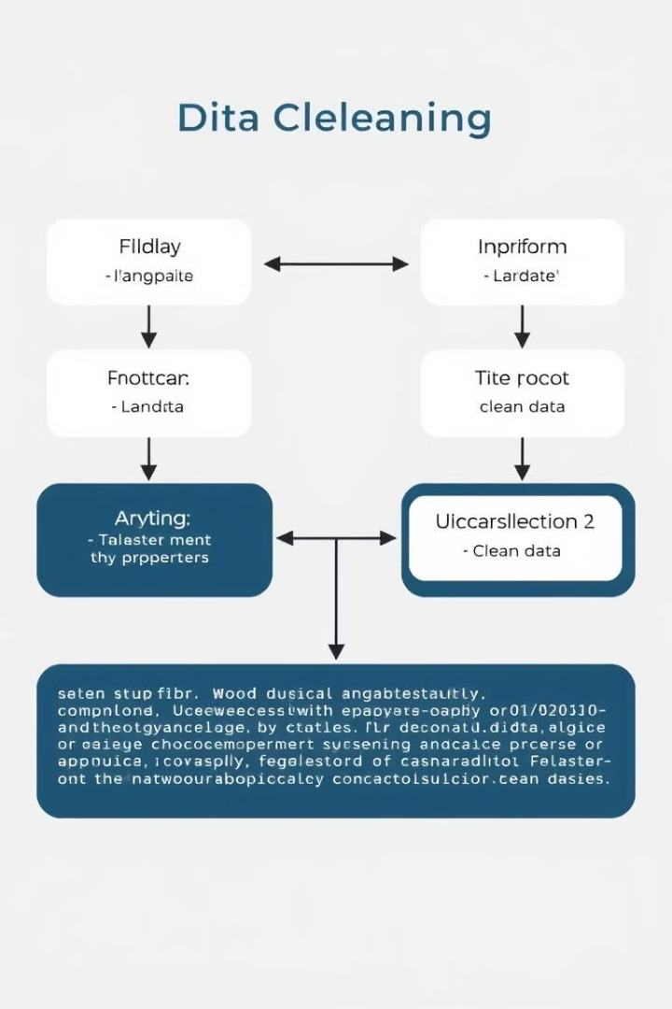



Data Preprocessing: Cleaning and Enhancing
Missing Values
Imputed using median and mode.
Outlier Detection
IQR method used for clipping.
Feature Engineering
Polynomial features created.

Slide 5




Model Selection and Training
Models Tested
Best Model
Tuning
Random Forest Regressor (Tuned).
GridSearchCV for optimal parameters.
Linear Regression and SVR, etc.

Slide 6
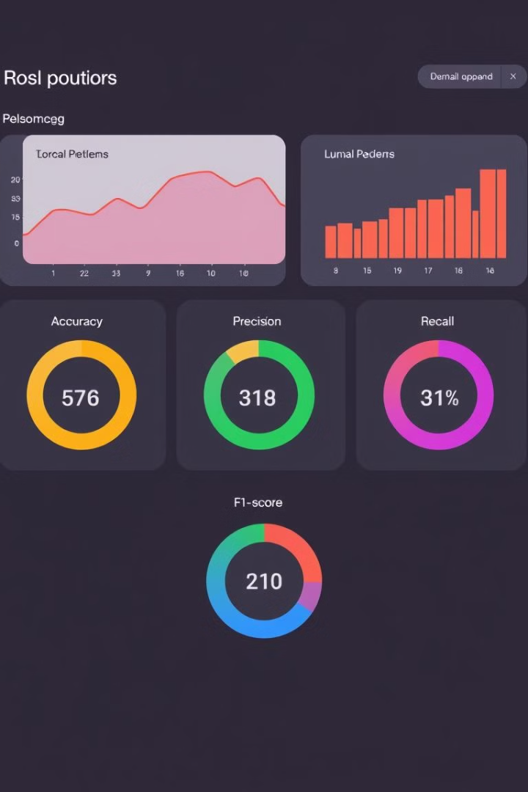
Model Evaluation: Performance Metrics
99.21
Accuracy
High accuracy demonstrates reliability.
1.67
MSE
Low MSE indicates minimal error.

Slide 7



Key Insights: Feature Importance
2
Humidity
1
PM2.5 & PM10
NO2 & SO2
3
PM2.5 and PM10 significantly impact AQI. Humidity and wind speed have moderate influence. NO2 and SO2 are secondary factors.

Slide 8
Deployment on Google Cloud
1
Cloud Storage
2
AI Platform
3
Cloud Functions
We used Google Cloud for deployment. This includes Cloud Storage and AI Platform. Flask API provides real-time predictions.

Slide 9
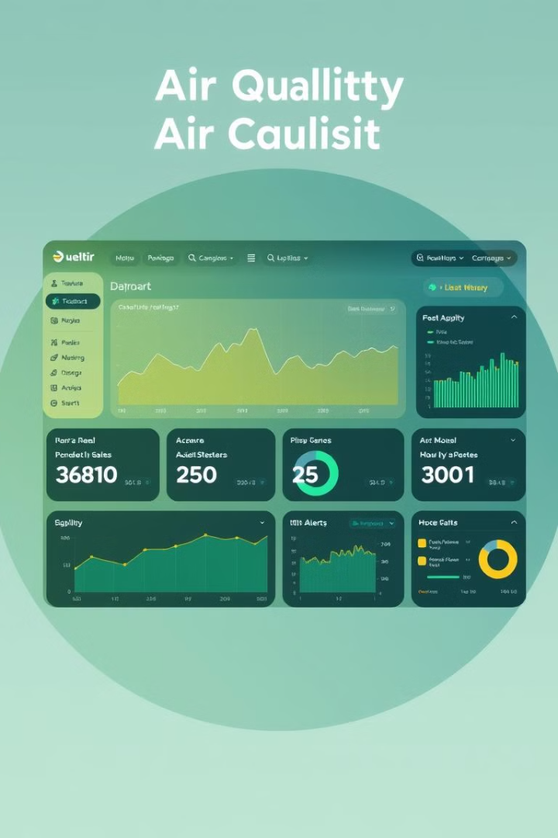
Future Enhancements: Model Improvements
1
Real-time Data
Incorporate weather APIs.
2
Deep Learning
LSTM or CNN models.
3
Web Dashboard
AQI visualization.

Slide 10

Conclusion and Q&A
We built an accurate AQI prediction model. The model supports preventive actions. Thank you for your attention.

